Slide 1
Detecting malicious Website Using its URL
ELG7186[EG]-Group 18

Slide 2
Our Team
Abdallah Ragab
Ahmed Abdo Zaid
Eslam Khalaf
Demiana Khar
300327288
300327306
300327261
300327265

Slide 3
Agenda
01
Problem Statement
DataSet Description
02
03
Evaluation Metric
04
ML Models
05
DL Models
06
Compare Models
07
Conclusion

Slide 4


Problem Statement
Many unauthorized websites are using to steal the user
Information.
Our goal is detecting the malicious websites.

Slide 5

Dataset Description
651,191 URLs with 4 classes
{
428103 benign,
96457 defacement URLs,
94111 phishing URLs,
32520 malware URLs.
}
https://www.kaggle.com/datasets/sid321axn/malicious-urls-dataset

Slide 6
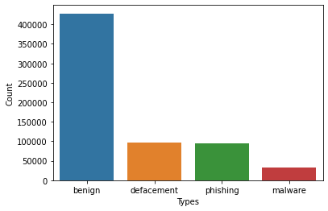
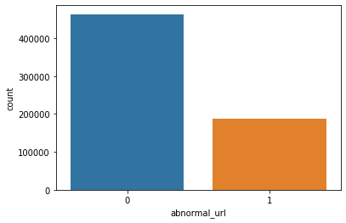
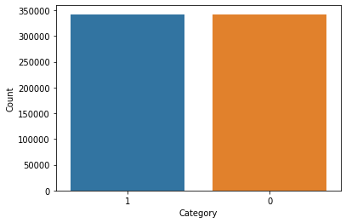
1 : 3 columns
1 benign column : 3 unsafe column
Concatenate the 3 malignant columns
Class 1 is imp.
Upsampling for training set

Slide 7

Evaluation Metrics
Recall
Because we are interested mostly in False Negative class (the attack)

Slide 8
Step 1 ML

Slide 9
WHAT DO WE DO?
1st | Checking for NaN values | There no NAN values
2nd | Feature Extraction | url,type,Category,url_len,domain,special letters features [@ ? - = . # % + $ ! * , //] ,abnormal_url,https,digits,letters,Shortining_Service,having_ip_address
3rd | Upsampling Malicious Class | The dataset was unbalanced
4th | Training models with Hyperparameter tuning | → Decision Tree → AdaBoost → Random Forest → Gaussian NB → Extra Trees → KNeighbors
5th | Voting Classifier for 4 Top Models | → Gaussian NB → KNeighbors → Random Forest → Decision Tree
6th | Multi-Layer Perceptron Neural Network(MLP) VS. ML Models | ML Model was Winner

Slide 10
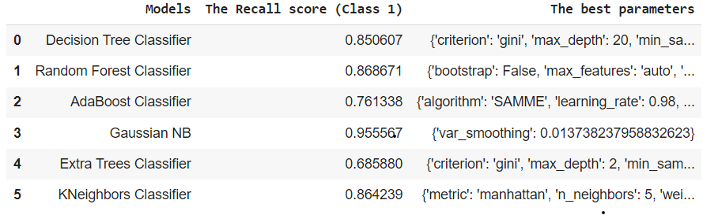
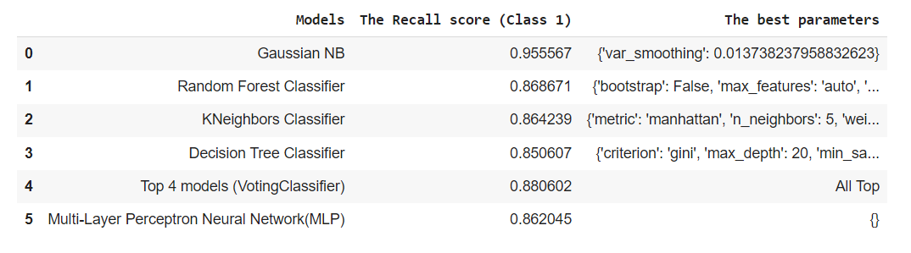
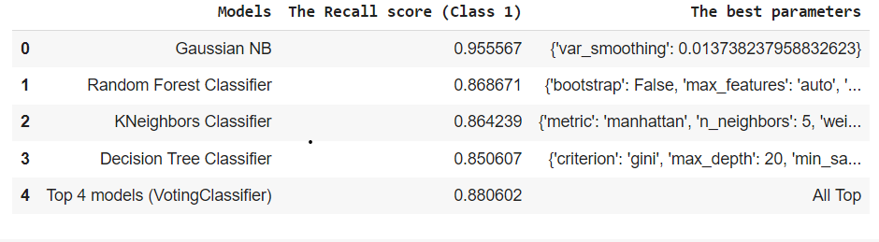
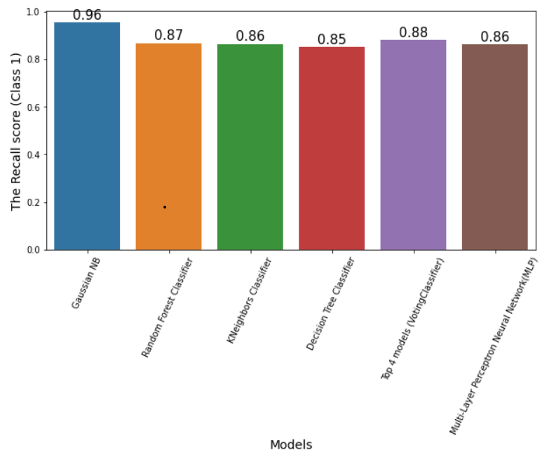
Comparison
1st ML Models
3rd MLP vs. ML Models
2nd Voting for 4 Top ML Models
4th Models Visualization

Slide 11
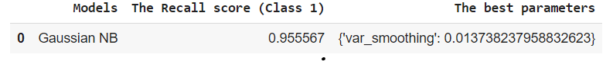
The Champion ML Models

Slide 12
Step 2 DL

Slide 13
Deep Learning Methodology
Perform Character Embedding
Implement different models
Select champion model

Slide 14
Deep Learning Methodology
Perform Character Embedding
Implement different models
Select champion model
Represent each character in the URL by a vector of length 128 and add this layer to the classification model to learn the best vector which represents each character.

Slide 15
Deep Learning Methodology
Perform Character Embedding
Implement different models
Select champion model
Embedding for “br-icloud.com.br”
b | 0.1680968 | 0.11709674 | 0.02931505 | …….. 128
r | 0.14431365 | 0.09179912 | -0.01556315 | …….. 128
. | …. | …. | …. | …….. 128
. | …. | …. | …. | …….. 128
b | 0.1680968 | 0.11709674 | 0.02931505 | …….. 128
r | 0.14431365 | 0.09179912 | -0.01556315 | …….. 128
.. 500 | …. | …. | …. | …….. 128
Represent each character in the URL by a vector of length 128 and add this layer to the classification model to learn the best vector which represents each character.

Slide 16
Deep Learning Methodology
Perform Character Embedding
Implement different models
Select champion model
Using CNN with a 1D convolution layer as feature extraction and trying different other models as classifiers such as LSTM and Bi-LSTM.

Slide 17
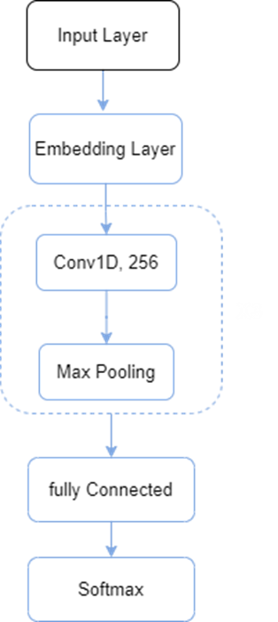
Deep Learning Methodology
Perform Character Embedding
Implement different models
Select champion model
CNN
Using CNN with a 1D convolution layer as feature extraction and trying different other models as classifiers such as LSTM and Bi-LSTM.

Slide 18
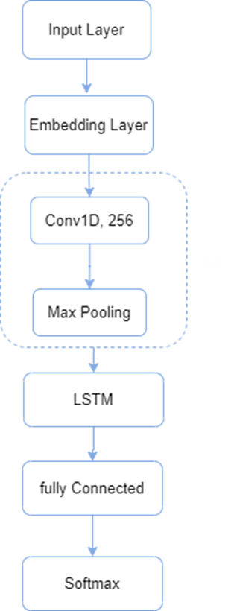
Deep Learning Methodology
Perform Character Embedding
Implement different models
Select champion model
CNN-LSTM
CNN
Using CNN with a 1D convolution layer as feature extraction and trying different other models as classifiers such as LSTM and Bi-LSTM.

Slide 19

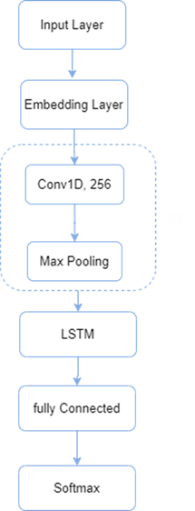
Deep Learning Methodology
Perform Character Embedding
Implement different models
Select champion model
CNN-BiLSTM
CNN
CNN-LSTM
Using CNN with a 1D convolution layer as feature extraction and trying different other models as classifiers such as LSTM and Bi-LSTM.

Slide 20
Deep Learning Methodology
Perform Character Embedding
Implement different models
Select champion model
Model | Recall
CNN | 97%
CNN-LSTM | 96%
CNN-BiLSTM | 97%
As CNN and CNN-BiLSTM have the same Recall we selected the champion model based on the confusion matrix.

Slide 21
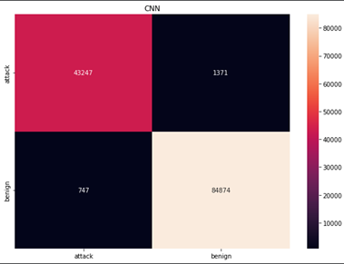
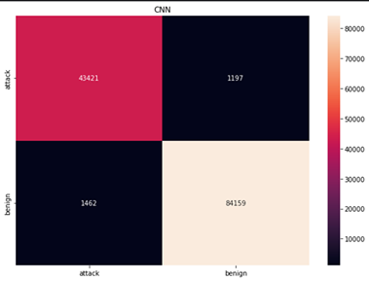
Deep Learning Methodology
Perform Character Embedding
Implement different models
Select champion model
CNN-BiLSTM
CNN
As CNN and CNN-BiLSTM have the same Recall we selected the champion model based on the confusion matrix.
Model | Recall
CNN | 97%
CNN-LSTM | 96%
CNN-BiLSTM | 97%

Slide 22
Deep Learning Methodology
Perform Character Embedding
Implement different models
Select champion model
As CNN-BiLSTM has low false negative classifications so we selected it as the champion Model in DL
As CNN and CNN-BiLSTM have the same Recall we selected the champion model based on the confusion matrix.
Model | Recall
CNN | 97%
CNN-LSTM | 96%
CNN-BiLSTM | 97%
CNN
CNN-BiLSTM

Slide 23
Step 3
ML vs DL

Slide 24
Compare ML and DL Model
Model | Recall
Naïve base | 96%
CNN-BiLSTM | 97%

Slide 25
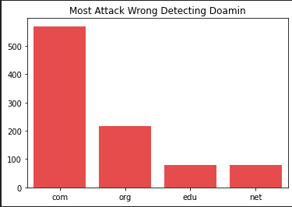
Error Analysis
Most domains that confuse the model
The model classifies them as normal but the true label is malicious, that happens because these domains appear as normal URLs more than a malicious ones.

Slide 26
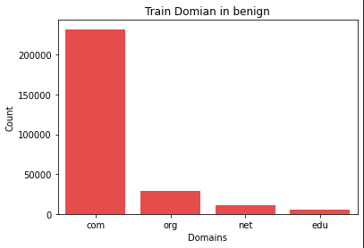
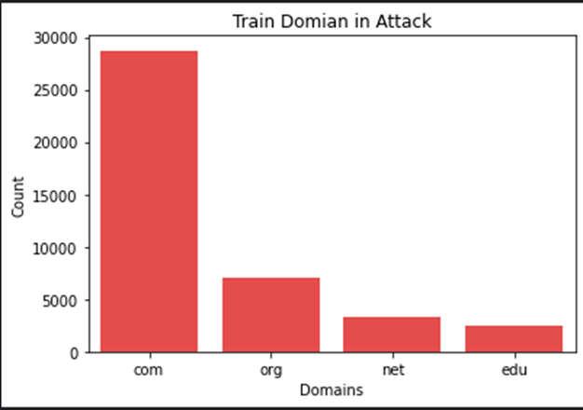
Error Analysis
Most domains that confuse the model
The model classifies them as normal but the true label is malicious, that happens because these domains appear as normal URLs more than malicious ones.

Slide 27
Conclusion
Detecting a malicious website is an important task to protect internet users, By implementing ML and DL models to solve this task, the DL model with character embedding has the best Recall and a probabilistic model like naive baya performs well in this task.

Slide 28
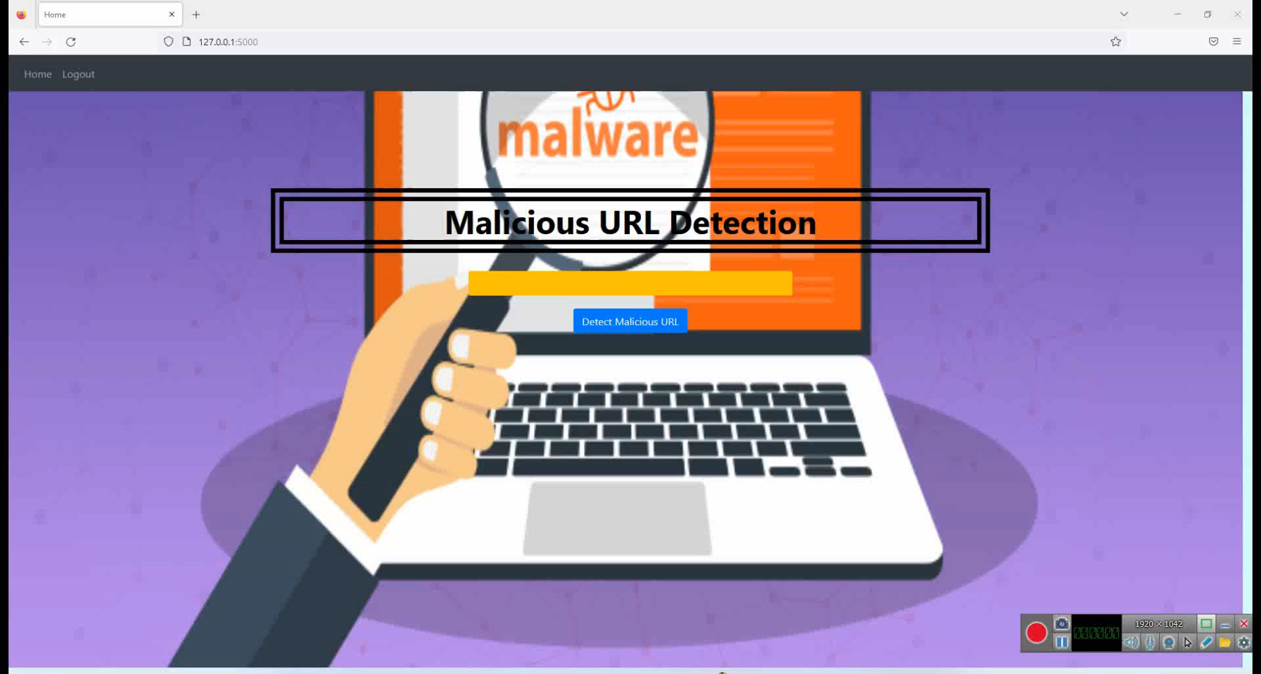
Deployment and Demo

Slide 29
Thank You

